Slide 1
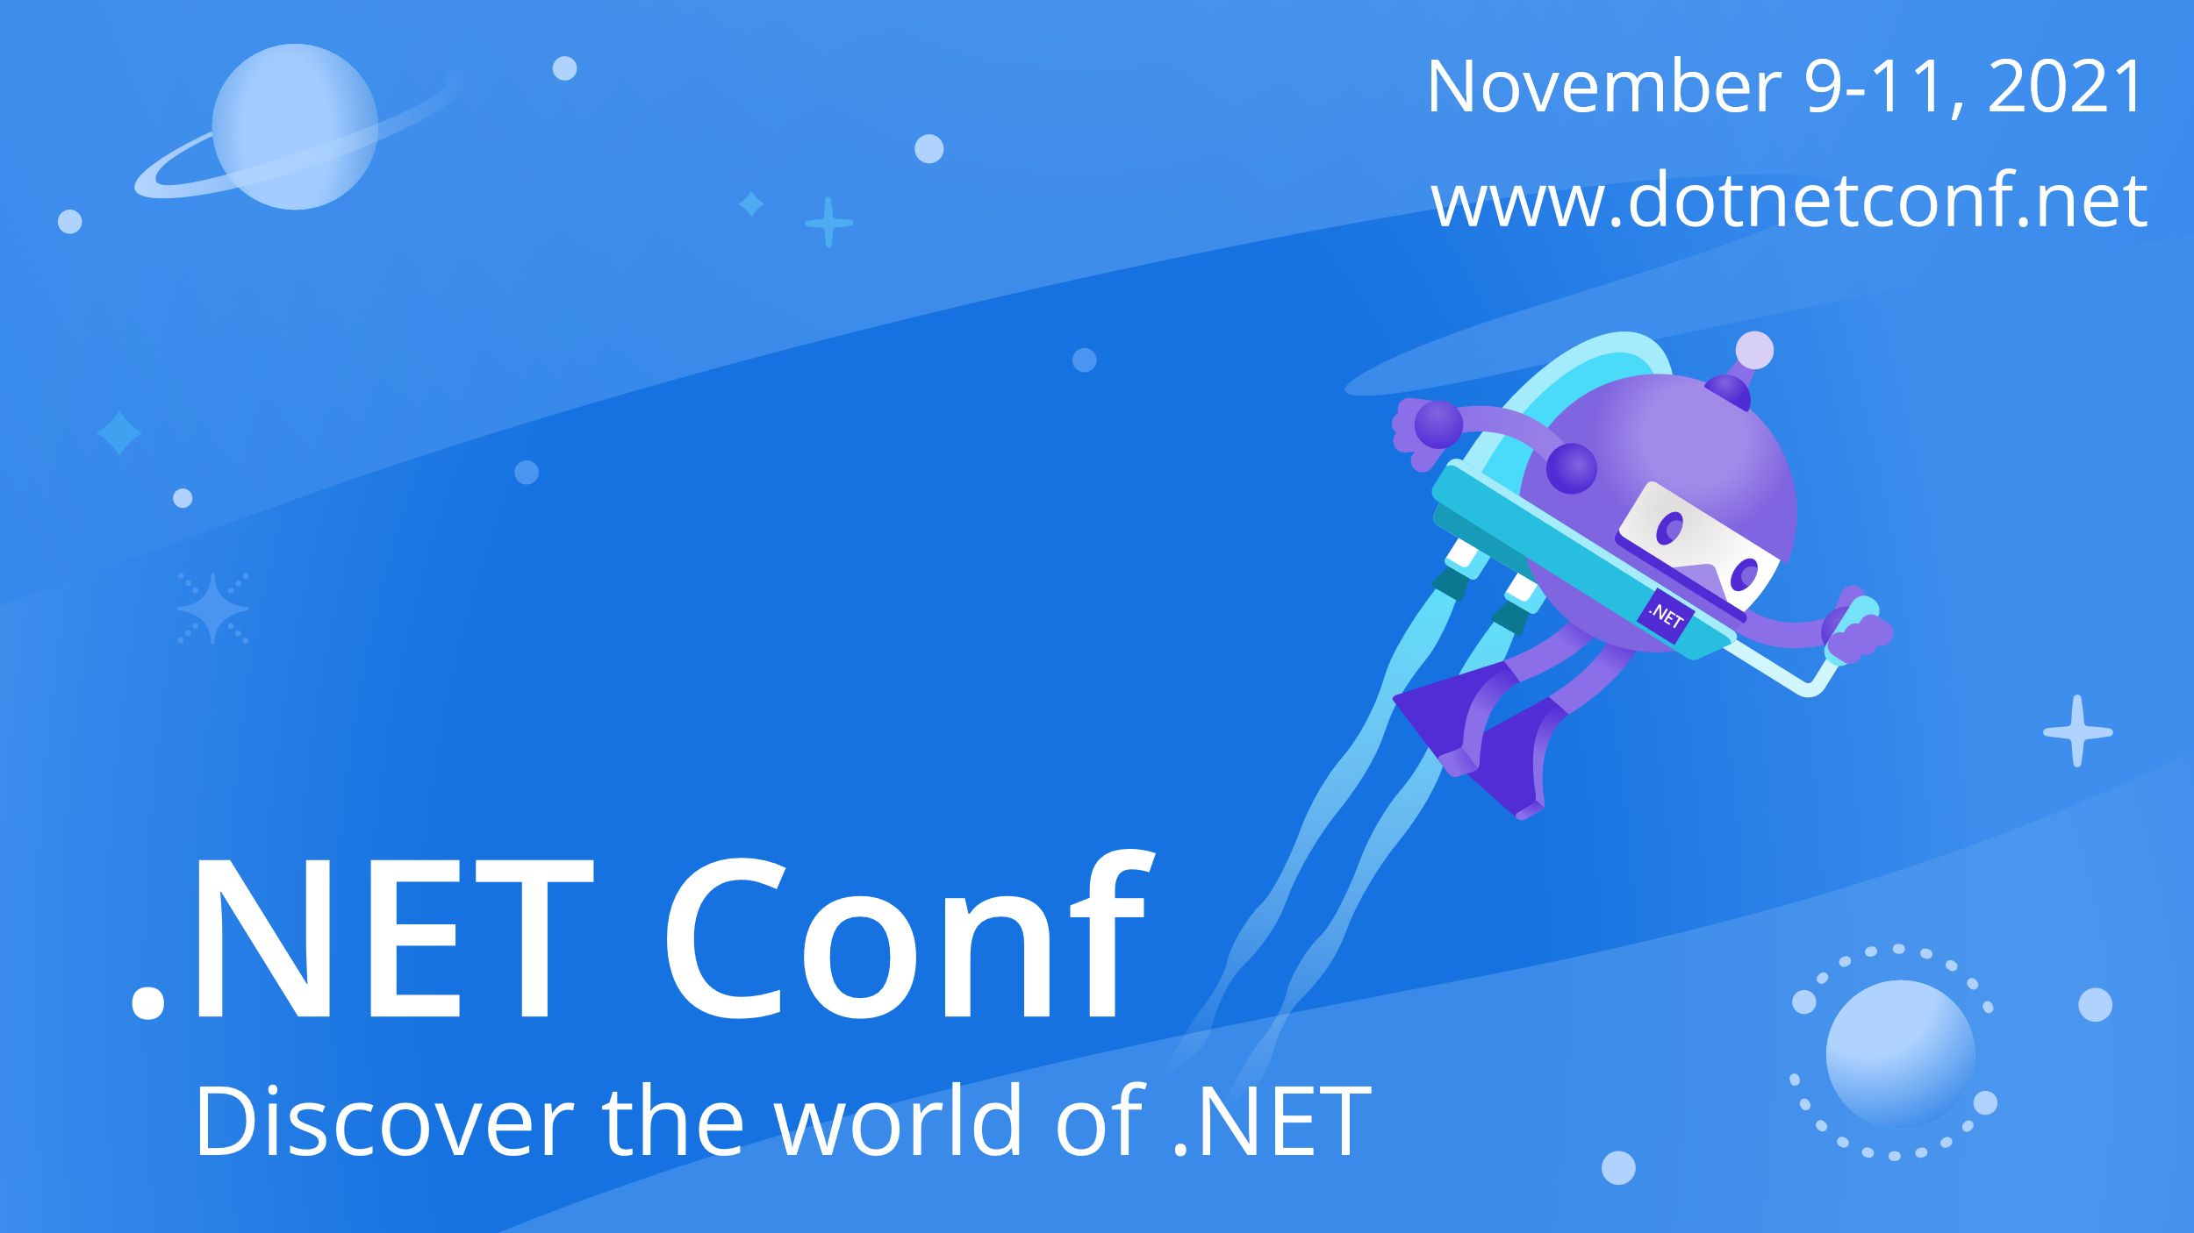

Slide 2


Host, deploy and scale ASP.NET Core Blazor Server
Jose Javier Columbie
@jjcolumbie

Slide 3

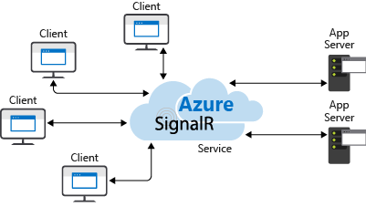



Slide 4
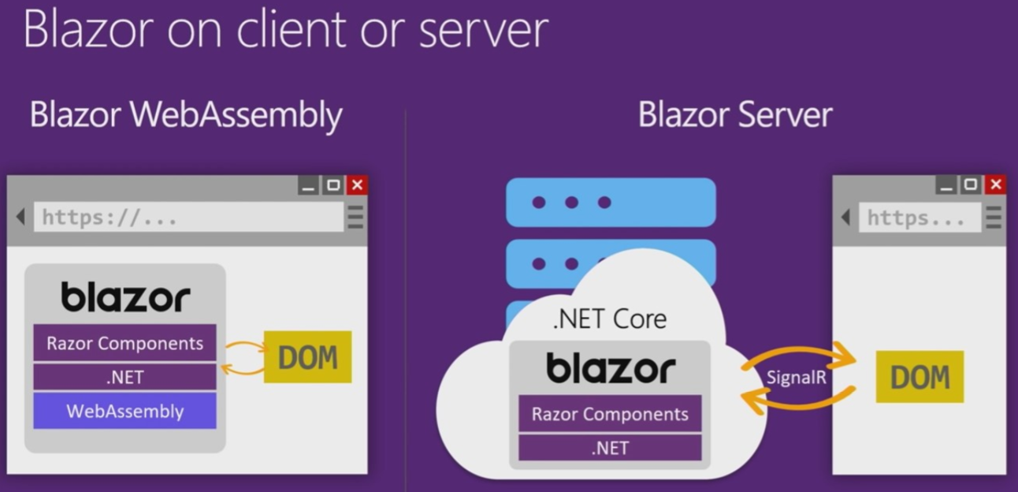
Blazor

Slide 5
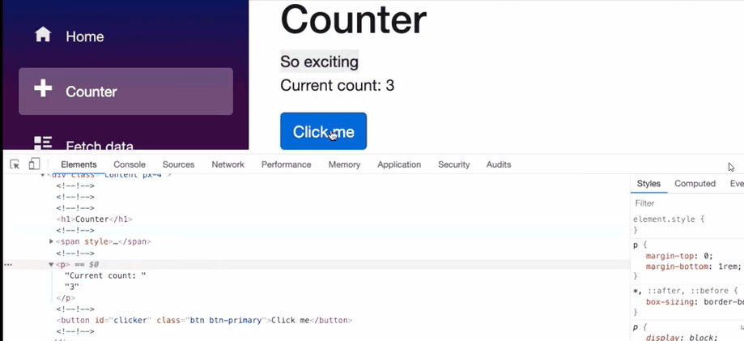
Blazor Server

Slide 6
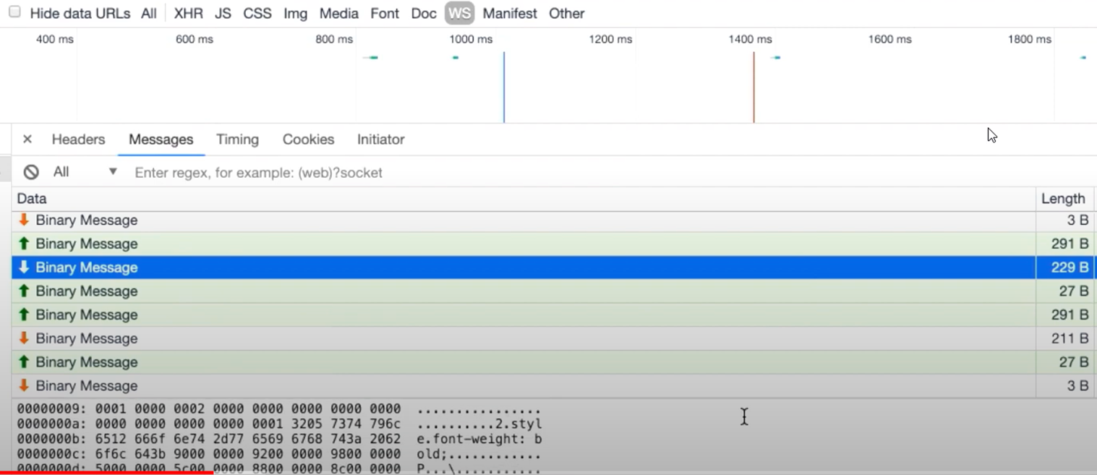
Blazor Server

Slide 7
SIGNALR
Library for adding real-time functionality to applications.
Server code push content to connected clients instantly as it becomes available, rather than having the server wait for a client to request new data.

Slide 8
SIGNALR
HTTP
AJAX
Server code push content

Slide 9
SIGNALR
WebSocket
Event Source (Server Sent Event)
Forever Frame (iframe)
Long Polling

Slide 10
WebSocket - WS
Bi-directional (persistent connection)
Multiuser
Full duplex
Asynchronous

Slide 11
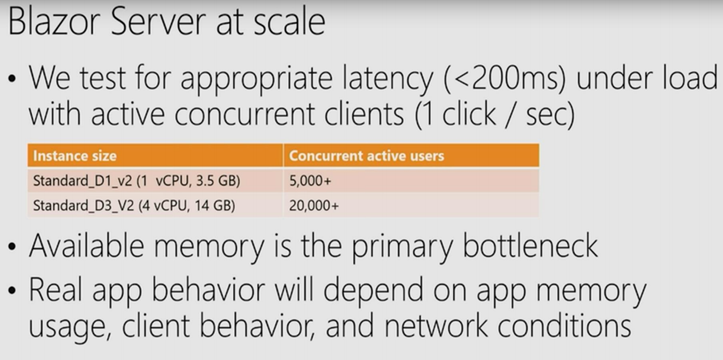
SIGNALR – Scaling

Slide 12
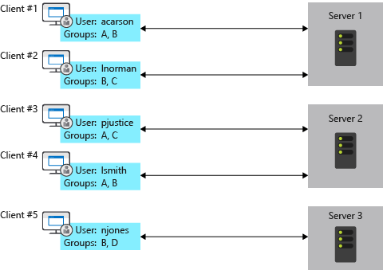
SIGNALR – Scaling
Sticky Sessions
TCP connections
Scale out
Azure SignalR Service and Redis backplane

Slide 13
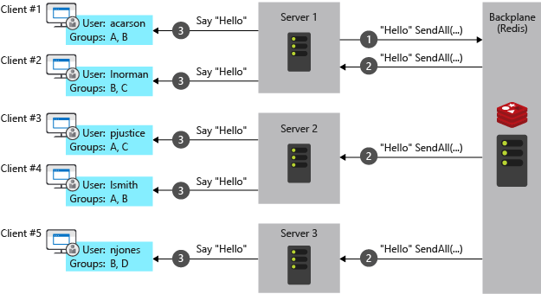
Redis backplane

Slide 14
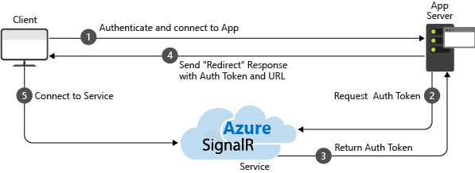
Azure SignalR Service

Slide 15
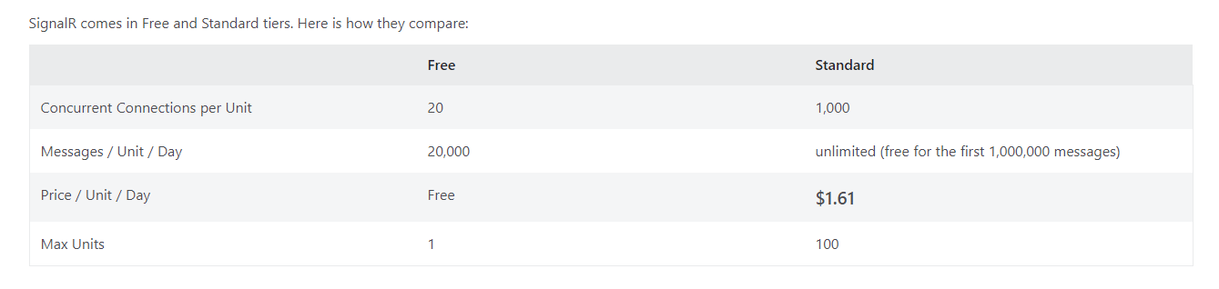
Azure SignalR Service - Pricing

Slide 16
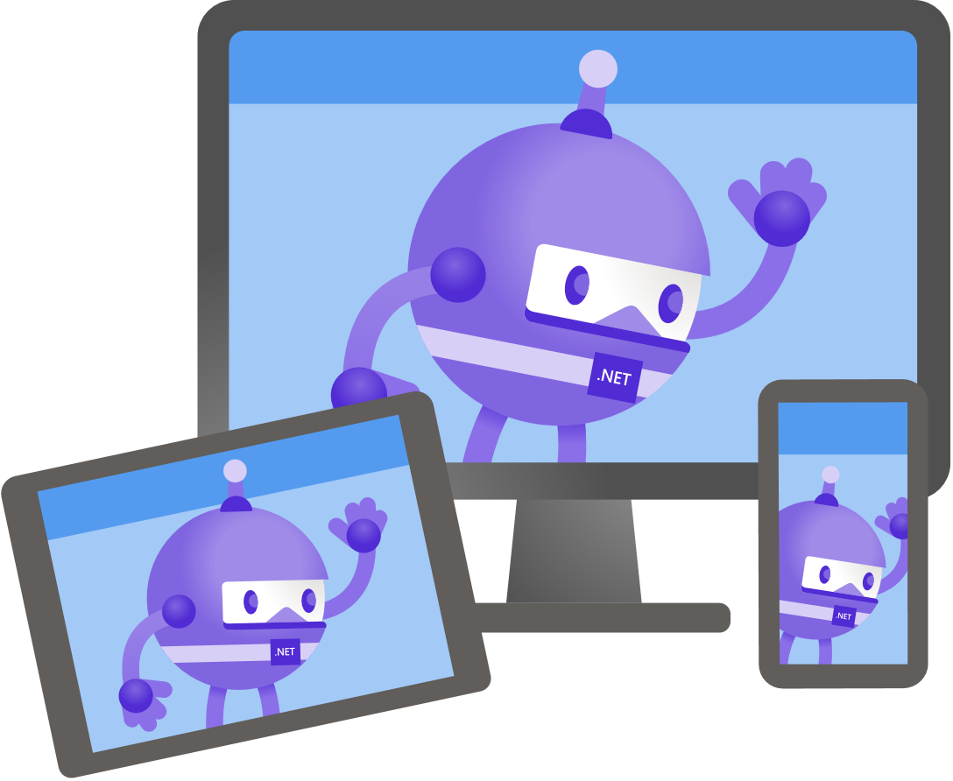
Demo
Jose Javier Columbie
@jjcolumbie

Slide 17
BONUS
CircuitHandler
CircuitOptions
HubOptions

Slide 18

Thanks for joining!

